Slide 1
Summary of Axtria Blog on Pharma Sales Force Sizing -Classic Approaches and Usage
https://insights.axtria.com/blog/pharma-sales-force-sizing-strategy-part-1-classic-approaches
&
https://insights.axtria.com/blog/pharma-sales-force-sizing-strategy-which-approach-to-use

Slide 2
Six classic approaches – Advantages and Limitations
Approach | Advantage | Limitation
Same as last year: Name explains all | Quick Simple Inexpensive | Internally focused No consideration for customer or future events No ROI or future forecast
Cost of sales: constant x% of sales (of corresponding financial year) | “ (shares all from above) ‘Dash’ of financial integrity | “ (shares all from above) This approach gets causal relationship WRONG i.e., sales force investment drives sales, not the other way around
Share of voice: set you sales force to that of your competitor’s size | Quick Simple Data available from 3rd party vendors Essentially diagnostic Externally focused | No consideration for customer or future events No ROI or future forecast Data can be hard to get Only diagnostic and not useful to prescribe what’s best for you

Slide 3
Six classic approaches – Advantages and Limitations (contd.)
Approach | Advantage | Limitation
Work Build-up: Quantify the workload required to cover certain accounts (of interest) over a period. | Relatively quick Data is available, math is straight-forward Segmenting and quantifying customers, selling roles and defining essential work helps in implementation at later stage | Doesn’t include the profitability aspect No ROI or future forecast
Affordable Coverage: calculates sales force that can be afforded based on sales forecast, profitability, investment hurdles. This approach weighs the contribution of sales force to sales. | “ (shares all from above) Strong financial fundamentals/Analytical rigor Perspective on ‘Carry-over’ and ‘Sales due to effort’ from salesforce and other channels | Math is complex, ‘Carry-over’ and ‘Sales due to effort’ variables are difficult to build Depends primarily on ‘sales forecast’ being available, so ROI vs. sales force variation is NA

Slide 4
Six classic approaches – Advantages and Limitations (contd.)
Approach | Advantage | Limitation
Sales Response Modelling: Statistical analysis that estimates sales revenue vs. sales force size variation. This approach allows for maximizing profit through minimum cost to sales force effort | Highly defensible as sales executives use the same financial terminology (incrémental revenues, marginal contribution, long term ROI, etc.) Enables scenario analysis Model analysis can be applied upstream to ‘Mix Marketing’ Model analysis can be applied downstream to ‘Call Planning’ and ‘Customer Valuation’ | Requires granular, reliable sales activity data Consumes time and effort Analysis is relatively difficult

Slide 5
Which approach is recommended?
Questions/factors taken into consideration for the right approach:
Time: How long does it take to conduct the analysis?
Data: Are the underlying data readily available? Are the inputs / assumptions easy to get?
Complexity: How difficult is the ‘math’?
Defensible: Can the approach pass muster with a CFO / CEO?
Forecast: Does it generate estimates of sales and profits?
Implementable: Can outputs be used to deploy, align, guide, and incent the sales force?
Cost: How costly is the approach?
Long term impact: Does the organization learn / get better?

Slide 6
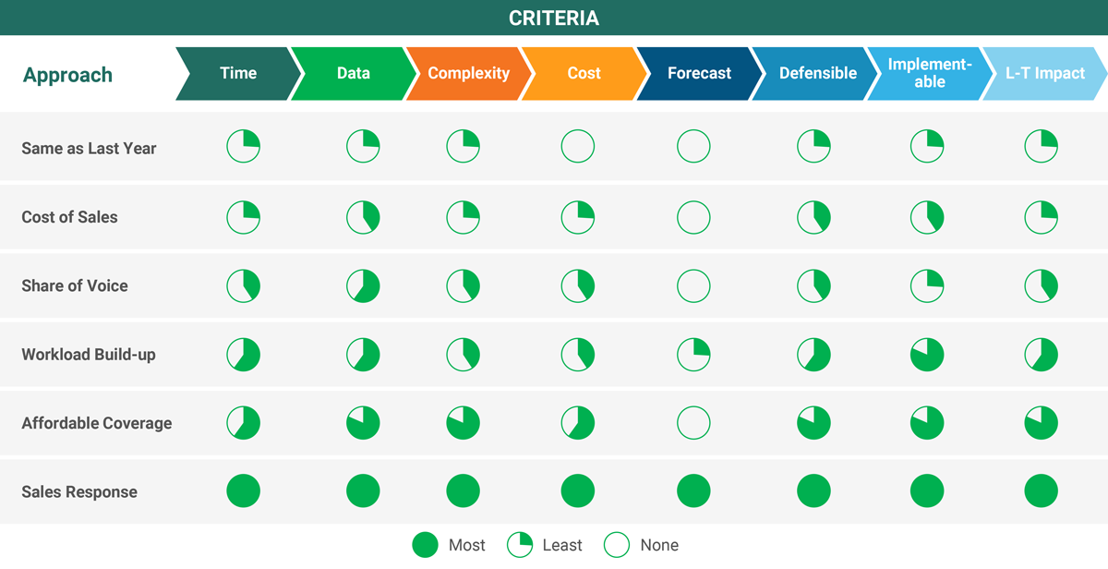
Which approach is recommended? (contd.)

Slide 7
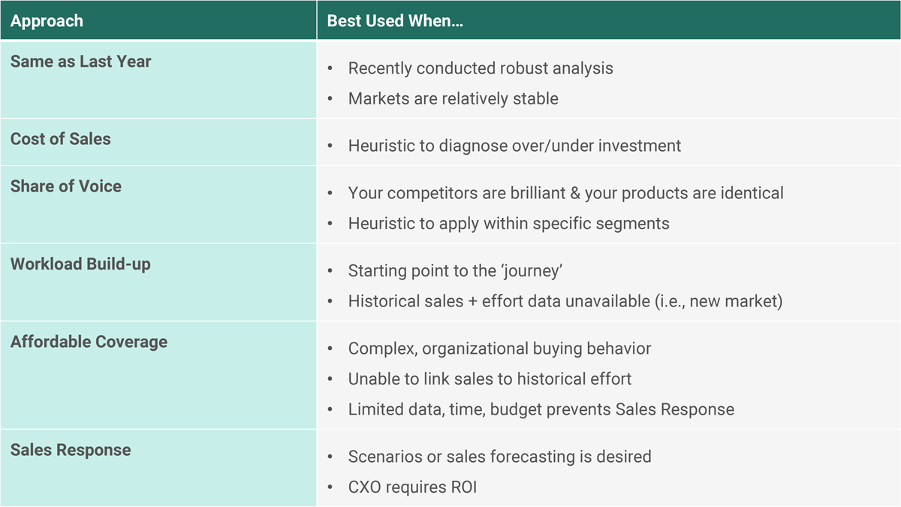
Which approach is recommended? (contd.)

Slide 8
Which approach is recommended? (contd.)
Axtria uses multiple approaches instead of leaning on one
A ‘crawl-walk-run’ strategy can be used: starting with ‘Work Build-up’ approach to understand the sales roles as well as customer segments
Next step can be ‘Affordable Coverage’ dealing with economics: ‘carry-over’ and ‘sales due to effort’ can be assumed. Costs per segment can be assessed at this step
Finally, commence ‘Sales Response Modelling’ and follow-up with Mix market analysis to check the sales force investment against all marketing spending (other channels, etc.)

